Slide 1
WEEKLY REVIEW · 22 – 29 JULY 2026
Re-measuring the diagnostic,
and a second chemical axis
Why last week's results are being withdrawn, and the monomer-B split built in their place
+0.048 eV
0.45 → 0.98
9 → 682
cost of a model-selection
bug, present since commit 1
group-mean R² across three
identical runs of one fold
monomers on the new
evaluation axis
Chloe Lin
Notes:
Headline: a reproduction check failed, which uncovered a bug in every runner and a variance problem. Results withdrawn and re-measuring. The week's constructive output is the monomer-B split plus two methodological findings.

Slide 2
SUMMARY
Three things happened
A reproduction check failed
1
Rerunning one stored result did not reproduce it. Tracing that uncovered a model-selection bug in all five training runners, present in each one's first commit.
Training is far noisier than assumed
2
Three identical runs of EA fold 1 gave group-mean R² of 0.450, 0.790 and 0.978. Most differences we have reported are smaller than that spread.
Built the monomer-B split
3
The A axis has only 9 monomers. The B axis has 682. Along the way: the B-monomer space turns out to be dominated by two scaffold families.
Net position: the 22 July model results cannot be defended and are being re-measured. The methodological contribution is larger than it was a week ago.
Notes:
Set expectations early: this is a correction week, not a results week.

Slide 3
FINDING 1
The bug: we tested the wrong model
Training tracked validation loss and saved the best checkpoint — then prediction ignored it and used the final model left in memory after early-stopping patience expired.
WHAT IT ACTUALLY COST
erratic
— Present in all five runners — hpg_hier, wdmpnn, and the stage2d path for ChemArch / GlobalArch / frac.
— From each runner's first commit — confirmed by git blame, so no stored prediction predates it.
— The model used was, by construction, worse than the one training had already selected — and worse by a random amount.
— Explains a puzzle: validation loss did not predict test performance, because the model being tested was not the one the validation loss described.
Measured on all 266 regenerated runs:
mean −0.003 to −0.022 eV by model,
median −0.003 eV, worst case +0.144.
Not a systematic penalty — a random one.
The +0.048 eV from six pilot runs was
not representative.
Fixed in all five runners. Best-checkpoint prediction is now the default, and both predictions are stored so the cost can be measured per model family.
Predicting from the selected checkpoint is still correct practice — but the bug's damage was random, not one-directional.

Slide 4
FINDING 2
The same run, three times
HPG-hier, EA, monomer-heldout. Same seed, same split, same code, same GPU model. Only the process differs.
GROUP-MEAN R² SD
0.018
0.091
fold 0
fold 1
— Fold 1's spread covers the entire quality range we have been reporting.
— Noise is fold-dependent — fold 1's SD is five times fold 0's.
— The "pathological folds" (EA 1, EA 6, IP 5, IP 2) are now suspected to be simply the high-variance folds.
— Fold 1 was recorded at 0.575 — one draw from this distribution. The unmodified model reaches 0.978 on it about one run in three, so per-fold conclusions from single runs are withdrawn.
Six V100 runs. Wall times 2,237–13,464 s — runs terminate at very different points.

Slide 5
PROTOCOL
The fix, and what we rejected
FROZEN PROTOCOL
TESTED AND REJECTED
VALIDATION DESIGN
Row-level validation
unchanged
one held-out monomer, as designed
Stabilised fold 1 but destabilised fold 0 (SD 0.018 → 0.034), doubled wall time, and would mean selecting on familiar chemistry while testing on unfamiliar.
MODEL SELECTION
best checkpoint
the bug fix
Minimum-epoch floor
REPLICATES
Aimed at a mechanism the data did not support — runs that trained longer were not better.
3 seeds, averaged
42 / 43 / 44, mean prediction reported
Averaging predictions over repeats improved every metric in every cell tested — 6/6 on MAE, 24/24 overall. We no longer depend on model selection behaving; we average over it.
Every model gets identical treatment — stated wherever results appear.

Slide 6
PART TWO
Two chemical axes, two different tests
Why the monomer-A split cannot measure what we claimed, and what the monomer-B split can

Slide 7
THE EXISTING SPLIT
How the monomer-A split works
The dataset is an exact factorial: 9 A monomers × 682 B monomers × 7 composition/architecture cells = 42,966 rows. Every A/B pair appears exactly 7 times.
ONE FOLD OF THE A-HELDOUT SPLIT — 9 DONOR MONOMERS
A1
A2
A3
A4
A5
A6
A7
A8
A9
train
train
train
train
train
train
train
val
TEST
4,774 rows per monomer · 33,418 train / 4,774 validation / 4,774 test
consequence | why it follows
Models train on 7 donors | The split removes the test monomer and a second one for validation. Our "unseen chemistry" results are 7-example extrapolations.
Within a fold, A is constant | All variation across groups comes from B, composition and architecture — all seen thousands of times. An error on the held-out A enters as a near-constant offset.
Novelty is one number per fold | A single held-out monomer means no within-fold similarity variation, so no performance-versus-novelty analysis is possible.
A identity carries 42% of EA variance and 50% of IP variance — across only 9 monomers.

Slide 8
EVALUATION FLOOR
The limitation, quantified
A null predictor that ignores the held-out monomer entirely: predict each test row from the training mean of its (partner monomer, composition, architecture) cell.
split | target | null floor (median group-mean R²) | headroom to 1.0
A-heldout | EA | 0.676 | 0.324
A-heldout | IP | −0.034 | 1.034
ON EA FOLD 2
0.961
0.922
the null
HPG-hier
A predictor with no knowledge of the
Why EA and IP diverge. The null's error is essentially the held-out donor's own offset. Whether that matters depends on its size relative to variation across groups within the fold, which comes from B.
held-out monomer beats our model.
— EA — B spread is large (2.93 eV), donor offsets are small, so the null reconstructs most of the signal. The metric is near-degenerate.
— IP — A carries more variance (0.500) and the B spread is smaller (1.76 eV), so the missing offset dominates and the null collapses. The metric is sound.
This also undermines the earlier claim that wDMPNN wins EA chemistry, 0.965 vs 0.925.

Slide 9
WHY A SECOND SPLIT
Which axis carries the signal
Both monomer roles carry comparable variance. What differs by two orders of magnitude is how many monomers carry it.
 | monomer A | monomer B
distinct monomers | 9 | 682
rows per monomer | 4,774 | 63
EA variance share | 0.418 | 0.457
IP variance share | 0.500 | 0.329
spread of means, EA | 1.36 eV | 2.93 eV
spread of means, IP | 1.18 eV | 1.76 eV
Murcko scaffolds | 9, closely related | 112
Architecture — the signal we actually study — is 0.98% of EA variance and 1.46% of IP. Monomer identity is ~90%.
Conclusion: EA chemistry claims belong on a B split; IP chemistry claims belong on the A split.

Slide 10
THE NEW SPLIT
How the monomer-B split is built
Nine folds over the 682 B monomers, grouped by Murcko scaffold so that chemically related monomers are held out together.
— Group the 682 B monomers by Murcko scaffold. Side chains are stripped; monomers sharing a ring system land in the same family. This gives 112 families.
— Pack whole families into nine folds of 75–76. Families are placed largest-first into the fold with the most room, so related chemistry is held out together rather than scattered across folds.
— Test = fold k, validation = fold k+1, cyclically. Validation monomers are B-disjoint from both train and test, so nothing in the stopping signal appears in the test set.
— 33,390 / 4,788 / 4,788 rows. Test size deliberately matched to the A split's 4,774, so fold-level metrics from the two splits sit on comparable footing.
— Frozen and asserted. Split seed 42, independent of the model seed. Fold membership is written to JSON and re-checked at the start of every run, so folds cannot drift across seeds.
DIFFICULTY, AGAINST THE A SPLIT
split | median NN Tanimoto | held out per fold
A-heldout (reference) | 0.31 – 0.47 | 1 monomer
B-heldout, clustered | 0.48 – 0.50 | 75–76 monomers
Grouping by scaffold keeps close analogues out of the training set, which brings the B split's difficulty close to the A split's — near enough that the two can be read side by side, with the caveat that they are not identical.
All 9 A monomers appear in train, validation and test — only the B axis is held out.

Slide 11
CONSTRAINT
Why a scaffold-disjoint split is impossible
Murcko clustering of the 682 B monomers gives 112 scaffolds — but the size distribution is extreme.
TOP TWO FAMILIES
62.5%
of all 682 B monomers
— One family has 317 members (46%), a second has 109 (16%).
— 64 scaffolds are singletons — but they cover only 9% of monomers.
— The largest family alone exceeds any balanced fold capacity, so nine equal scaffold-disjoint folds cannot exist.
— So the split is capacity-balanced scaffold packing — close to disjoint for the 110 small families, unavoidably not for the two large ones.
TEN LARGEST SCAFFOLD FAMILIES, BY MEMBER COUNT
This is a property of the benchmark, not of our split: any random split of it is mostly substituent interpolation.

Slide 12
INTERPRETATION
The consequence: two kinds of fold
Because the two large families must be split across folds, the nine folds are not exchangeable. The grouping below is derived from the frozen split, not assumed.
folds | what is held out | held-out monomers with a same-core relative in training | what it tests
0 – 3 | 76 members of the 317-family, each | 76 of 76 | new substituents on a familiar core
5 | 76 members of the 109-family | 0 of 76 (rest sit in validation) | a genuinely new core — but only one
4, 6 | 29 and 26 small families | 13 of 76 · 33 of 76 | mixed
7, 8 | 28 and 29 small families | 0 of 75 | new cores — the cleanest tests
Paired tests run within group. Pooling five folds that test substituent interpolation with four that test new scaffolds would mix two populations.
The cost: power. Groups of five and four give minimum attainable two-sided p of 0.063 and 0.125. We accept that rather than a significant-looking pooled number.

Slide 13
INTERPRETATION
So we read the two splits differently
 | A-heldout | B-heldout (clustered)
valid chemistry test for | IP — floor ≈ 0 | EA — floor 0.38, headroom 0.62
meaning of "unseen chemistry" | extrapolation from 7 examples | generalisation from ~530
held-out chemistries per fold | 1 | 26–29 (or 1 in folds 0–3, 5)
folds exchangeable? | broadly yes — 9 single donors | no — two structural groups
paired test | one 9-fold test, min p = 0.0039 | within group, min p = 0.063 / 0.125
novelty analysis | impossible | curve across 76 monomers per fold
contamination handling | none needed | filtered and unfiltered reporting
No single headline number per split. EA claims come from the B split, IP claims from the A split, and every group-mean R² is reported beside its fold-specific null floor and the fraction of available headroom it closes.

Slide 14
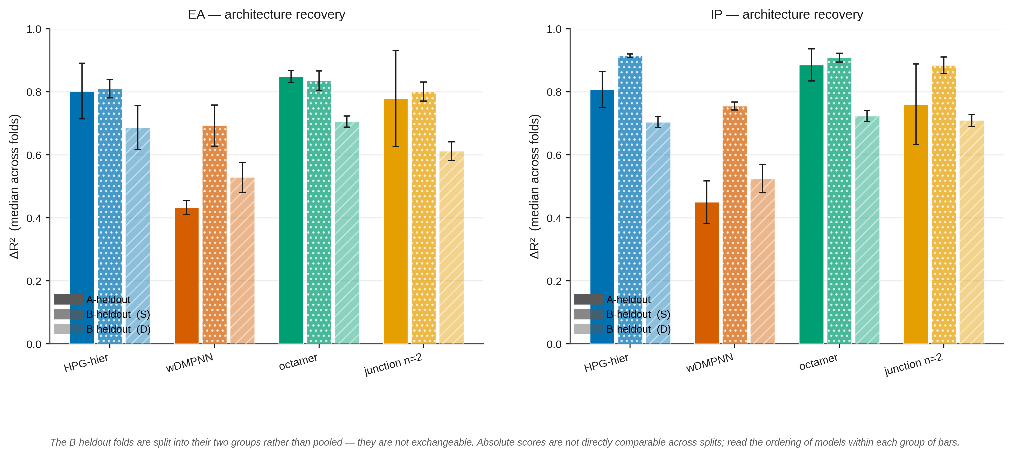
RESULT
The architecture advantage holds on both chemical axes
ΔR² median across folds, mean of three seeds, error bars = per-fold seed SD. B folds are shown as their two groups, never pooled — they test different things.
HPG-hier beats wDMPNN on ΔR² in every bar — both targets, the A axis, and both B-fold groups. Within group it loses 4 of 4 (S) and 5 of 5 (D), the maximum either group can show. The gap widened after the bug fix: wDMPNN's EA ΔR² fell from 0.58 to 0.43, so the old numbers were flattering the baseline, not our model.

Slide 15
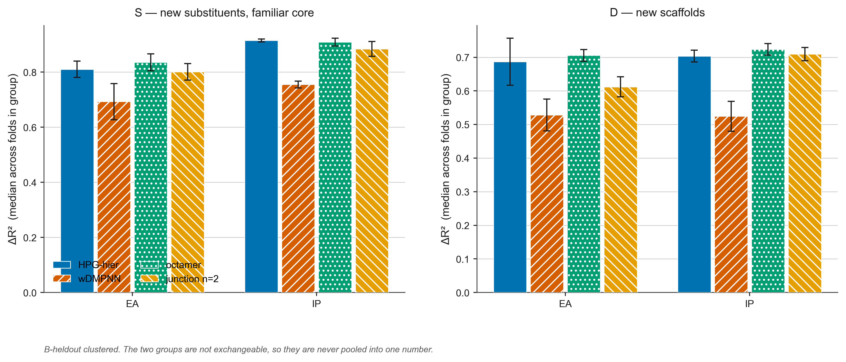
RESULT
The octamer gains only where the chemistry is new
B-heldout clustered, split by what each fold actually tests. This is why the fold grouping mattered.
Group D holds out whole new scaffold families; group S holds out new side chains on cores the model already knows. The octamer adds +0.019 / +0.032 ΔR² on D (5–0 folds both targets) and nothing on S (2–2). A representation change that helps only where the chemistry is genuinely new is what a real encoding improvement looks like — pooling the nine folds would have shown p = 0.18.

Slide 16
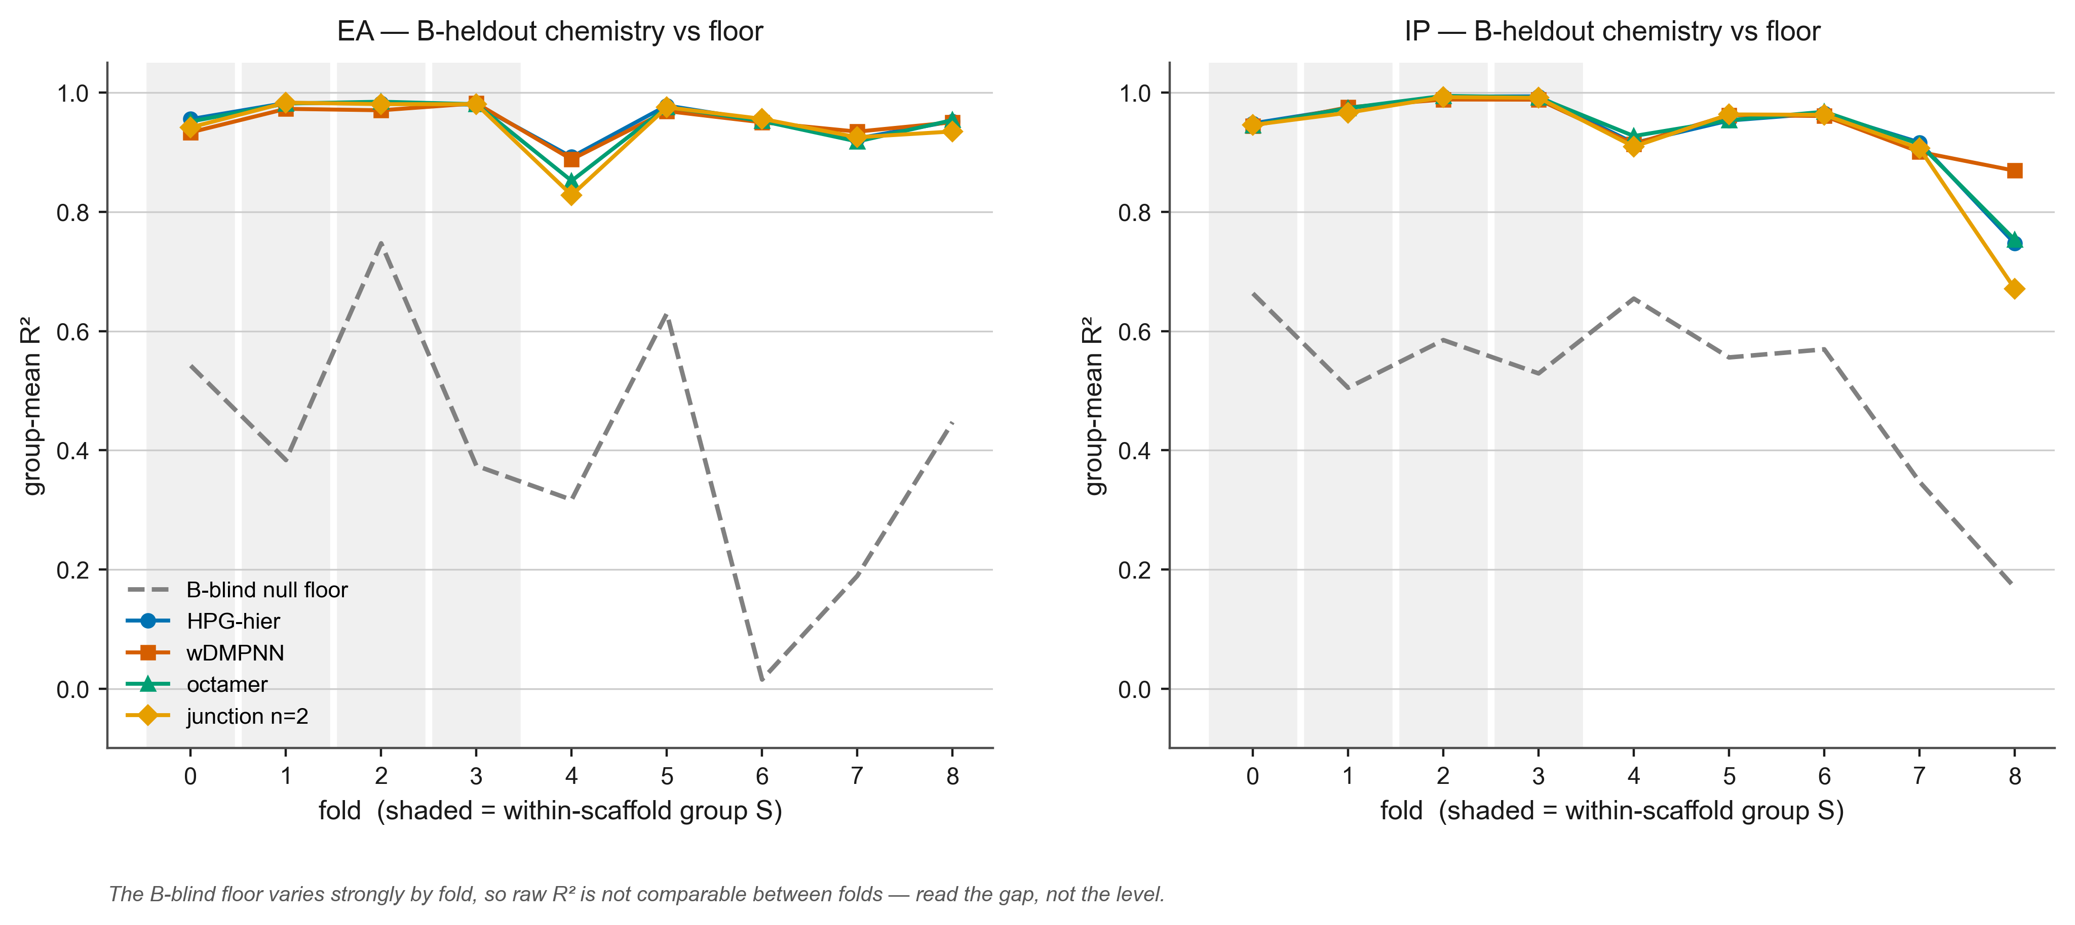
RESULT
Every model clears the floor — but the floor moves
Per-fold group-mean R² against the fold's own B-blind null floor. Shaded folds are group S.
The dashed line is a predictor that ignores the held-out monomer entirely. It ranges from 0.02 to 0.75 across folds, so raw R² is not comparable between them — read the gap, not the level. All four models sit well above it on the B split, which the A split could not demonstrate for EA.

Slide 17
NEXT
Where that leaves the programme
stage | status | what it gave us
R1 A-heldout, 270 runs | complete | architecture advantage confirmed with error bars; chemistry claims repaired
R3 B-heldout clustered, 216 runs | complete | advantage holds on the second chemical axis, 9 of 9 folds
R2 B-heldout random | deferred | clustered is the difficulty-matched split; little to add
R4 ChemArch / GlobalArch / frac | not run | their numbers are still from the buggy code — see below
481 of 486 cells landed; the five outstanding move no median measurably. 57 of 266 R1 runs were flagged undertrained and every table is reported with and without them.
FOR DISCUSSION
Paper scope
The measurement contributions — null-floor calibration, the two-axis split design, scaffold dominance in the benchmark — are now backed by a model result that holds on both axes. Lead with the methodology, HPG-hier as the case study?
ChemArch and the original HPG
Still un-regenerated, so they cannot share a table with these numbers. Either spend 162 runs, or cut them from the comparison.
Training stability
21% of runs stopped before epoch 10. Worth fixing properly before the next experiment, even though 3-seed averaging absorbs it.

Slide 18
WHERE THIS LEAVES US
A correction week that ended with a stronger result
1
Found before publication, not after
A reproduction check most people skip caught a bug that had been in every runner since its first commit.
2
Three findings the bug cannot touch
The null-floor calibration, the two-axis split design, and the scaffold dominance in the benchmark are all computed from data, not from model runs.
3
The model claim came back stronger
Architecture recovery is confirmed with error bars and holds on both chemical axes: ΔR² 0.80/0.81 vs wDMPNN's 0.43/0.45 on the A axis, and 9 of 9 folds on the B axis. The bug had been understating our own model.

Slide 19
PROVENANCE
Backup — how the fold grouping was derived
Nothing here is hand-assigned. The grouping is recomputed from the frozen split file every time the analysis runs.
1
Murcko scaffold per monomer
THE THRESHOLD IS NOT LOAD-BEARING
RDKit MurckoScaffold.MurckoScaffoldSmiles — strips side chains, keeps ring systems and the linkers between them. Bemis & Murcko, J. Med. Chem. 1996. Deterministic, no free parameters.
fold | share with scaffold in training | group
0 – 3 | 1.00 | S
6 | 0.434 | D
4 | 0.171 | D
5, 7, 8 | 0.00 | D
2
Group the 682 B monomers by identical scaffold
Gives 112 families. Acyclic monomers, if any, form singletons.
3
For each fold, ask whether the held-out chemistry is in training
Read held_out_monomer_B and train_monomer_B from the frozen JSON; count held-out monomers whose scaffold also appears among that fold's training monomers.
4
Label S if that share exceeds 50%, D otherwise
The nearest fold to the cut is 0.434. Any threshold between 0.44 and 0.99 produces the identical grouping — the data are not near the boundary.
Threshold fixed in advance. Also record distinct scaffolds per fold, and Morgan r=2 2048-bit Tanimoto novelty as an independent continuous check.
Code: scaffold_structure() in scripts/python/analyze_regen_v1_r3.py. Outputs: _regen_v1_r3_results_fold_composition.csv · originally computed in audit_b_heldout_design.py during split construction.

Slide 20
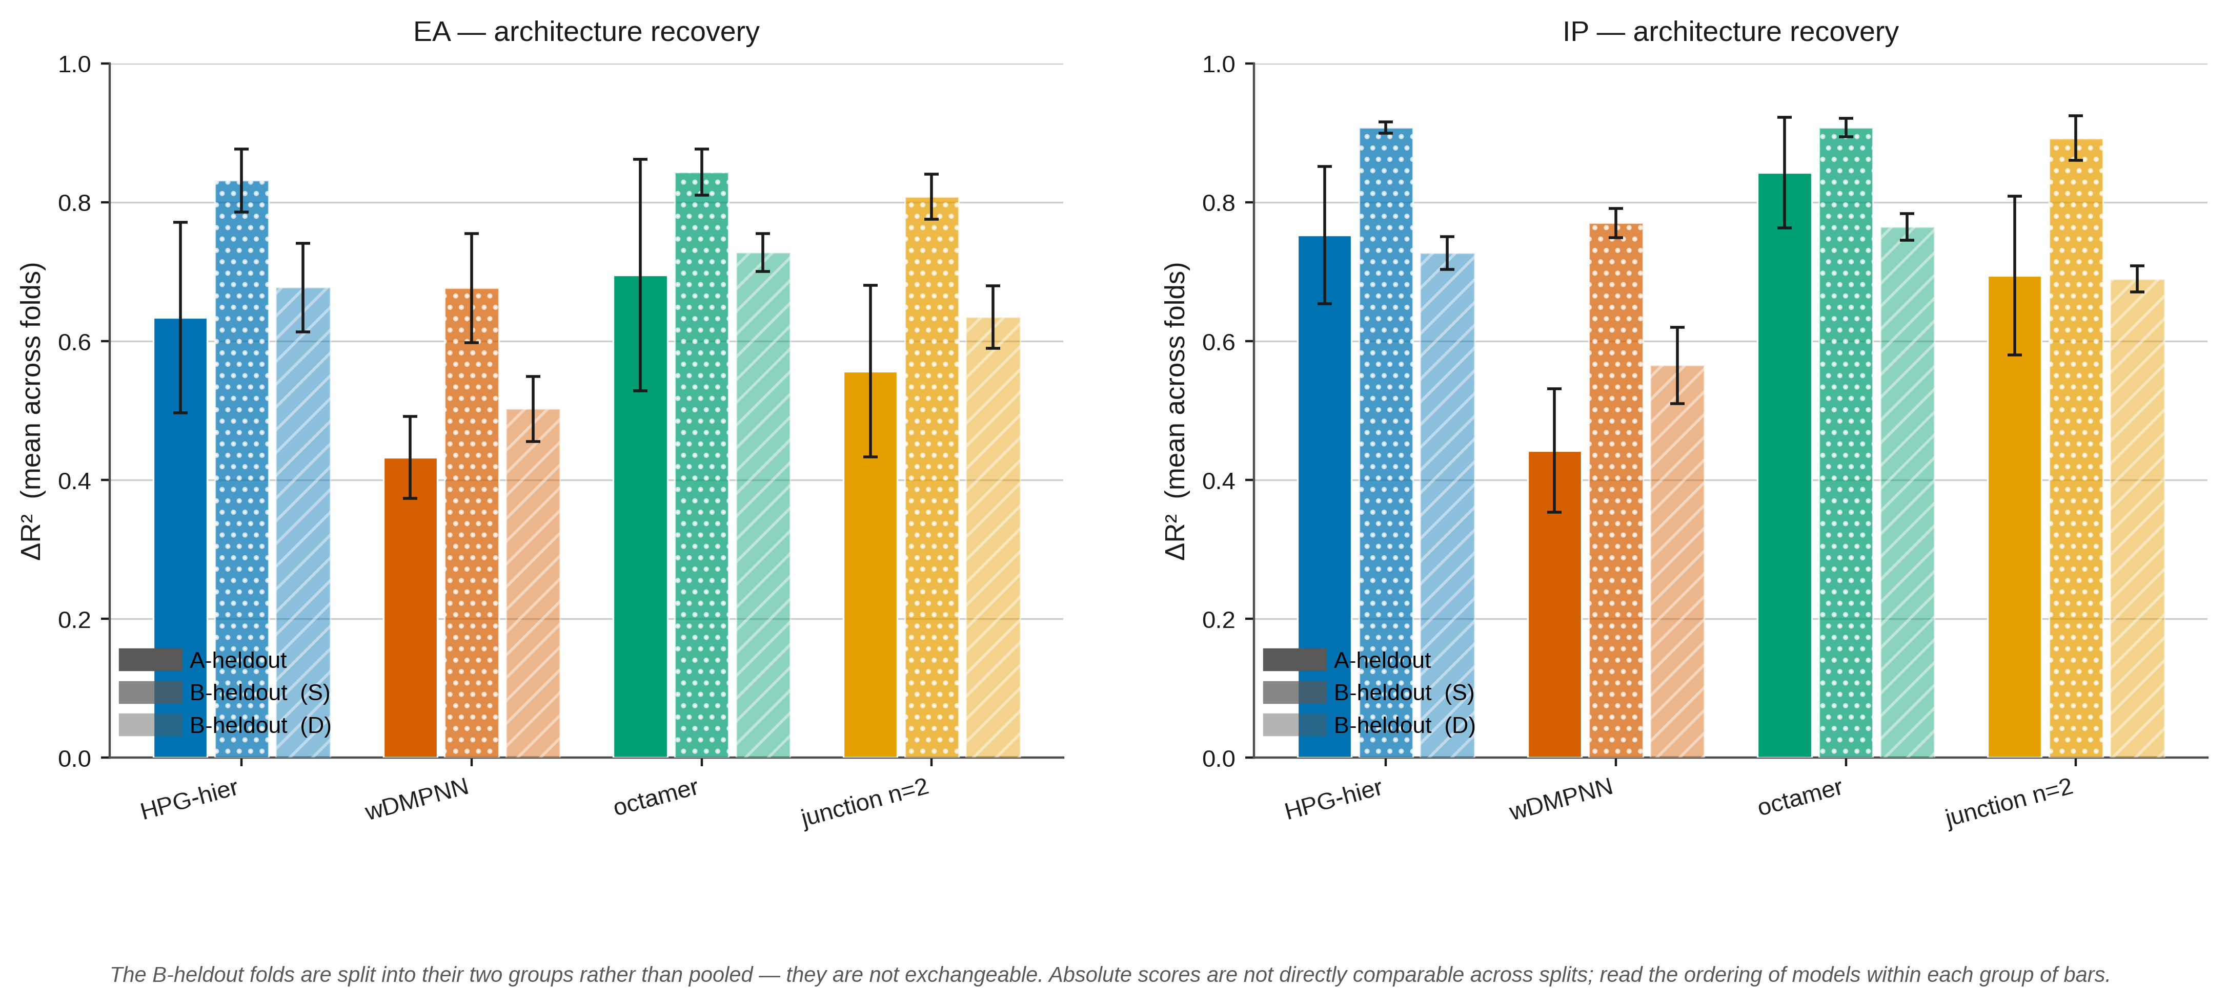
PROVENANCE
Backup — the same result using means, not medians
Medians are robust to the pathological folds; means are not. On the A split HPG-hier's EA ΔR² is 0.803 median but 0.634 mean, because one fold falls to −0.002. On the B split the same numbers are 0.778 and 0.746. The A folds are heterogeneous, the B folds are not — a second, independent argument for the B split.

Slide 21
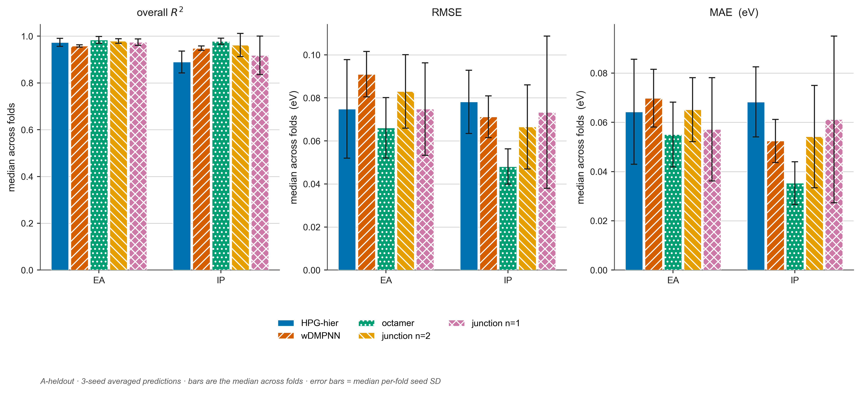
PROVENANCE
Backup — plain accuracy, no decomposition
Overall R², RMSE and MAE per model on the A-heldout split — the bottom-line numbers with no null floors and no group/deviation split. The octamer leads on all three; wDMPNN trails on R² despite competitive MAE, which is the decomposition showing up in aggregate.

